Slide 1
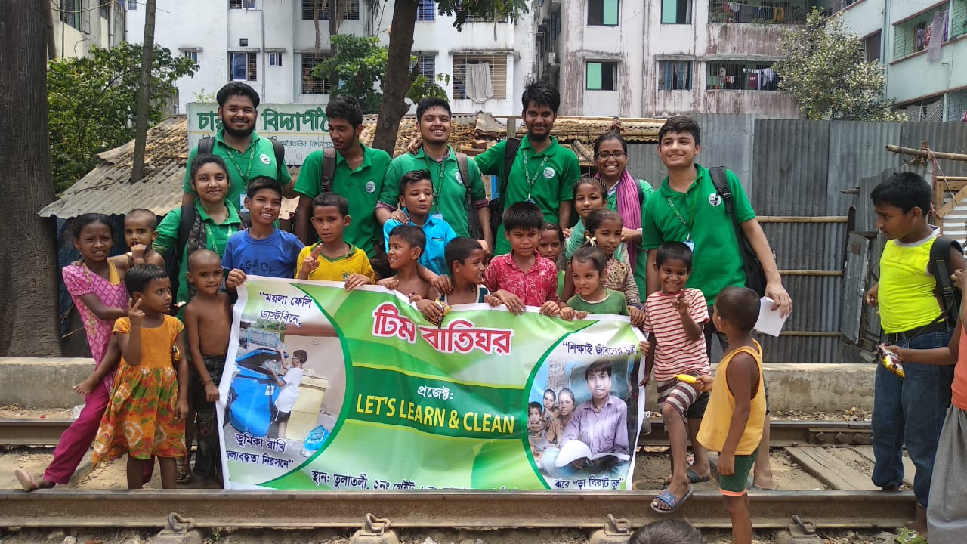
Team
Baatighor
Project: “ Lets learn and clean.”

Slide 2
Team Members
Ahasanul Haque Akib
Muntaka Chowdhury
Aishwariya Roy
Moushlah Uddin Bappo
MD Abdullah Al Mamun
Abdul Quddus Hawlader
Farjana Yeasmin Rafi
Ariful Islam Shifath

Slide 3
Tulatuli Area
8no. Shulokbohor ward, Chattogram.

Slide 4


Slide 5
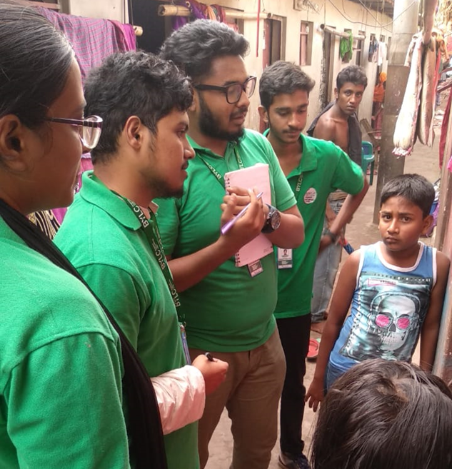
Day: 1
19th April 2019
Activities:
Cleaning seminar room.
Informing community people about our project and inviting them to take part in our LIA.

Slide 6
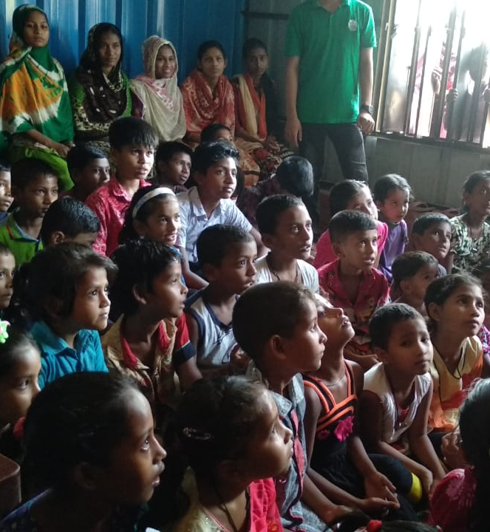
Day 2
20th April 2019
Activities:
Ice-breaking session with the children. About 55 children participated.
Challenges we faced:
Handling those kids properly.
Distributing snacks to them.
Complaints due to noise from adjacent school teacher.

Slide 7
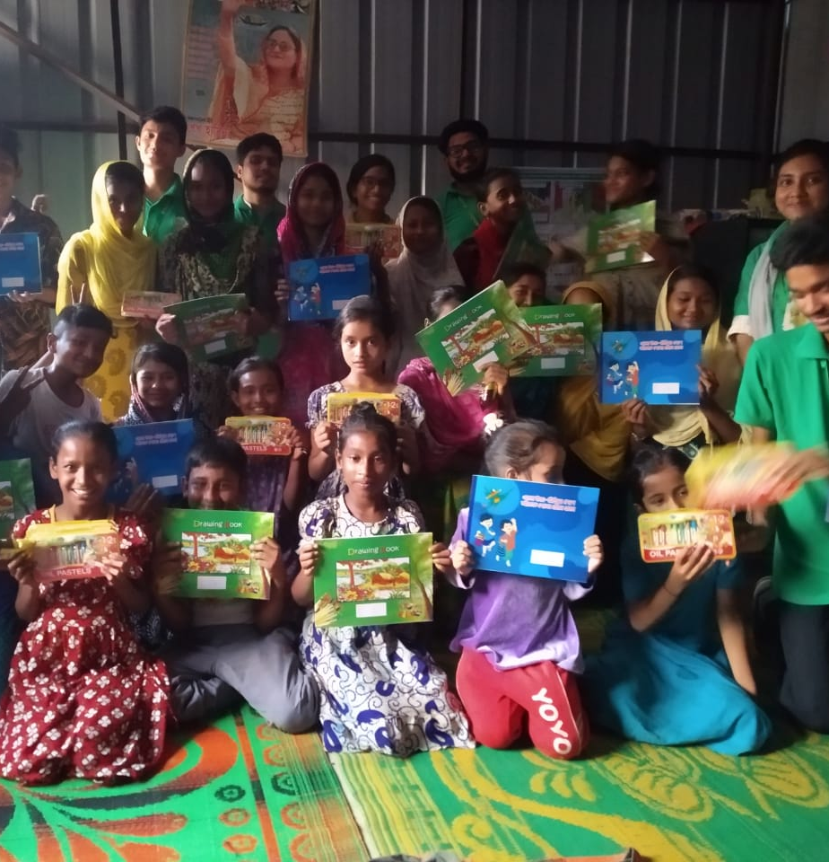
Day: 3
22nd April 2019
Activities:
Finished the incomplete ice-breaking session.
Arranged some fun activities for the kids.
Education awareness based discussion.
Distributed exciting gifts.

Slide 8
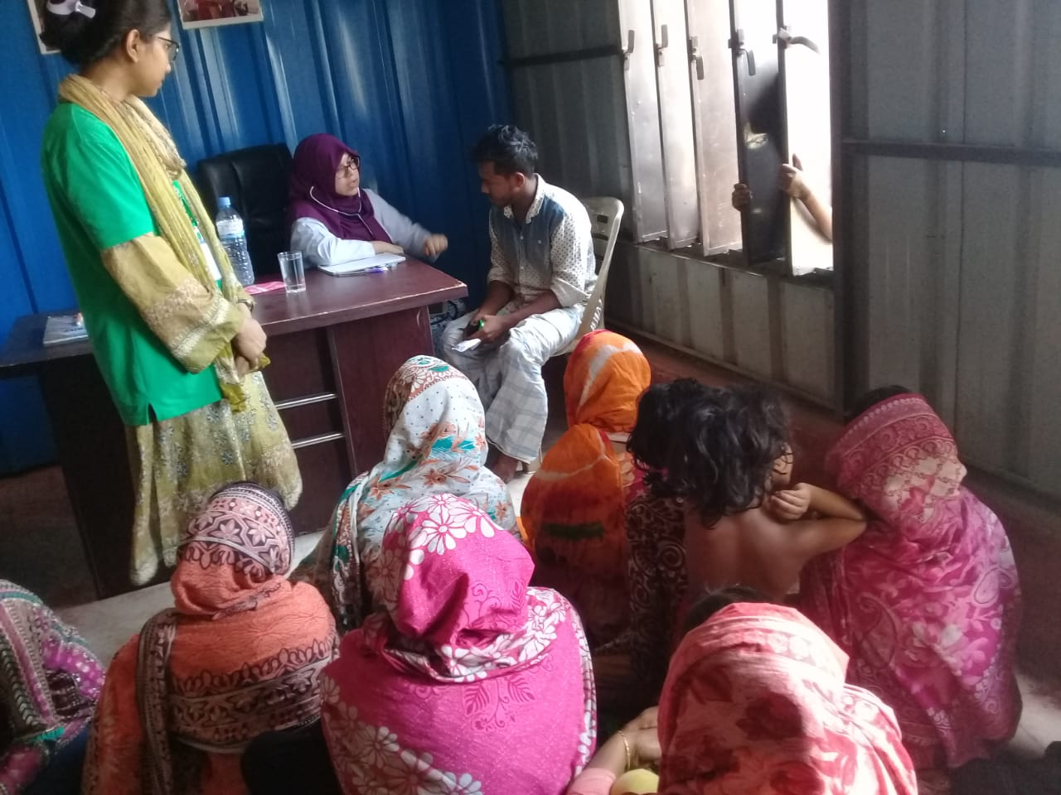
Day: 4
24th April 2019
Activities:
Session about hygiene and basic health issues by a doctor.
Free health check-ups
Challenges we faced:
To bring community people to the session.
Other community service committee used the half part of our seminar room.

Slide 9
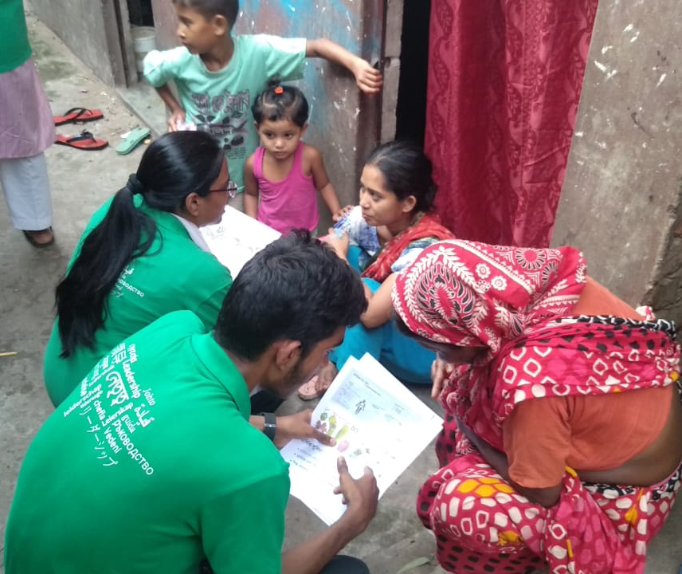

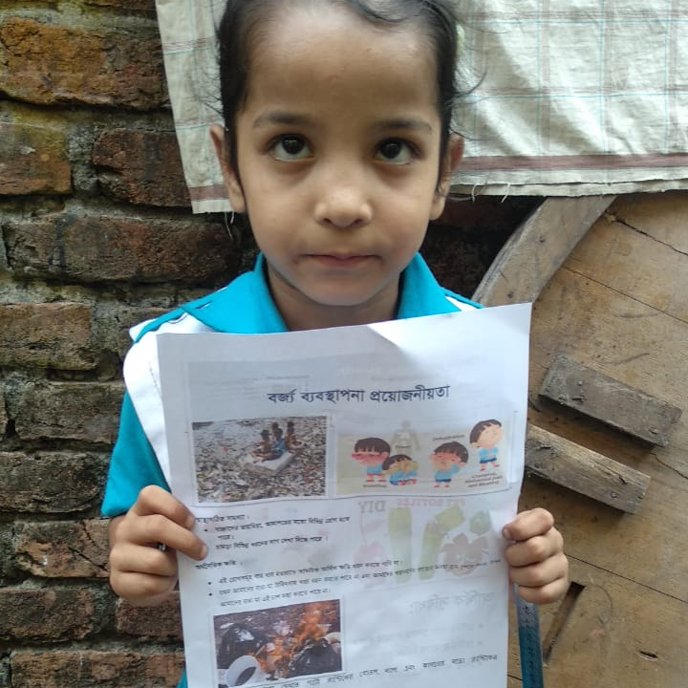
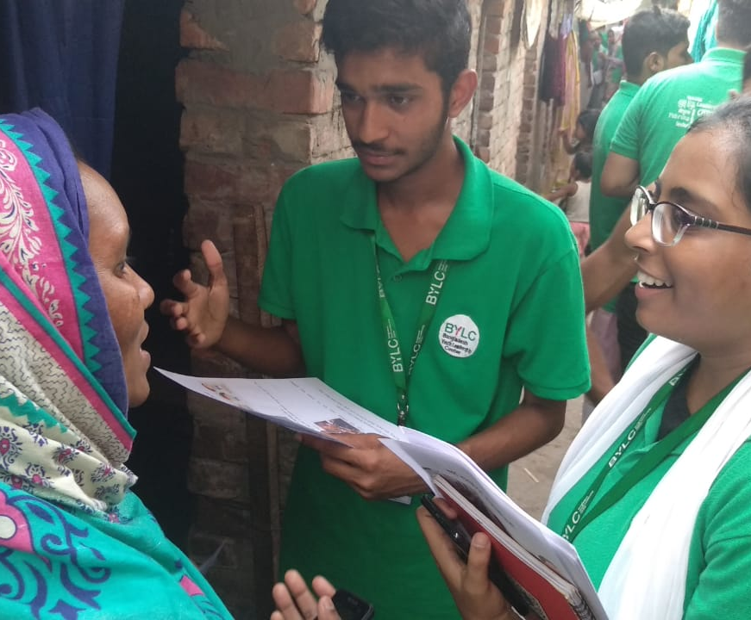
Day: 5
25th April 2019
Activities:
Door to door waste management awareness discussion.
Distributing leaflet about waste management

Slide 10
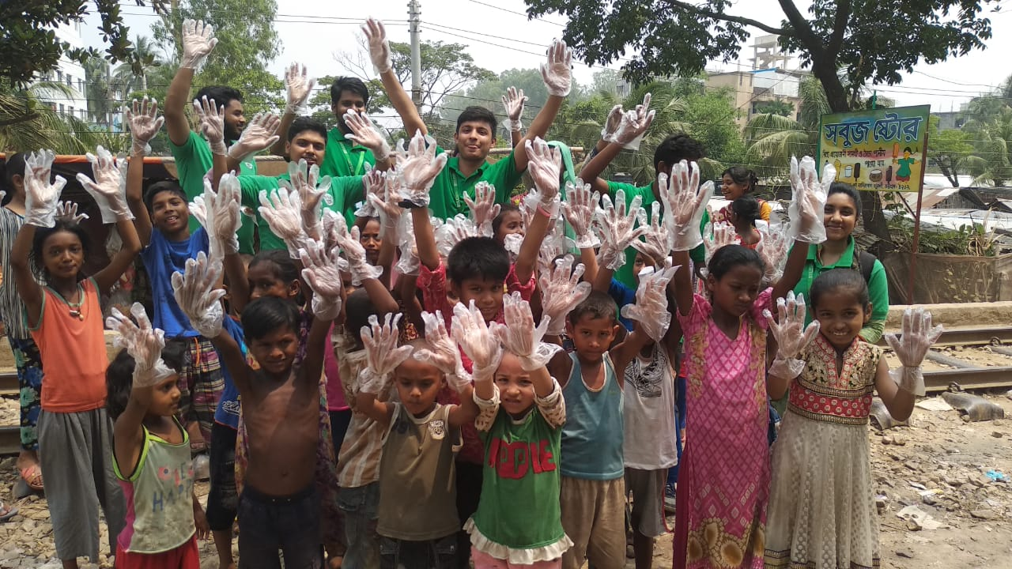
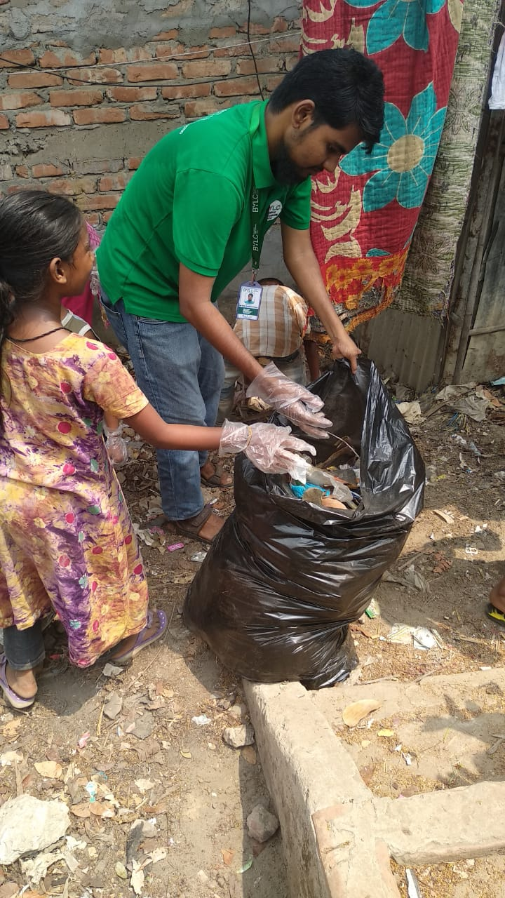
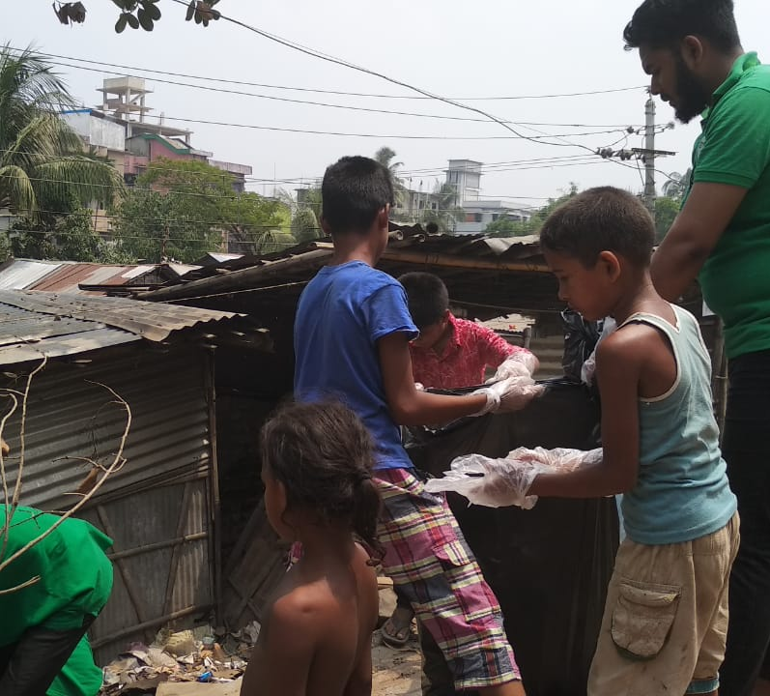
Day: 6
26th April 2019
Activities:
Cleaning environment along with children.
Challenges we faced:
According to action plan we could not set up trash bin and could not arranged waste management awareness session.

Slide 11

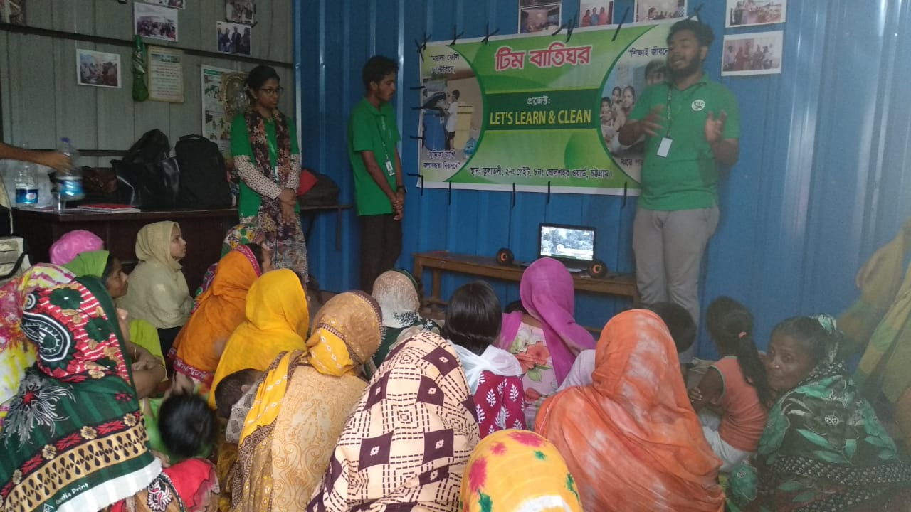
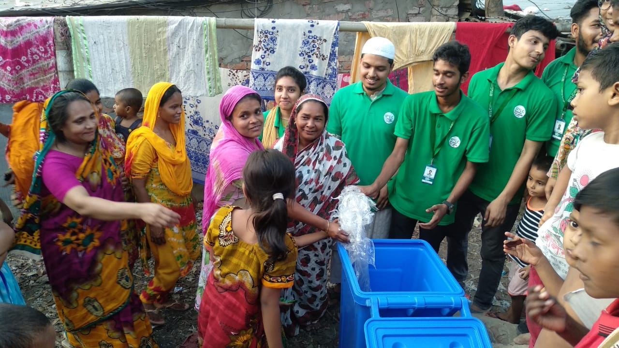
Day: 7
27th April 2019
Activities:
Arranged awareness session about waste management .
Setting up garbage bin.

Slide 12
Before LIA
N= 38 families.

Slide 13
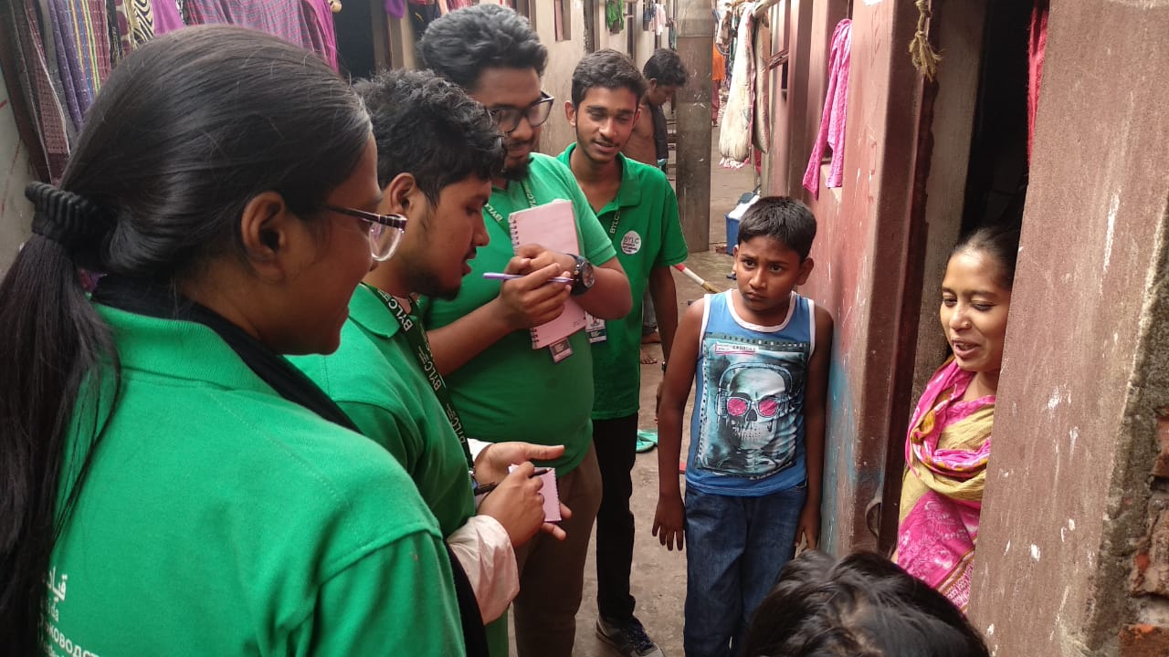
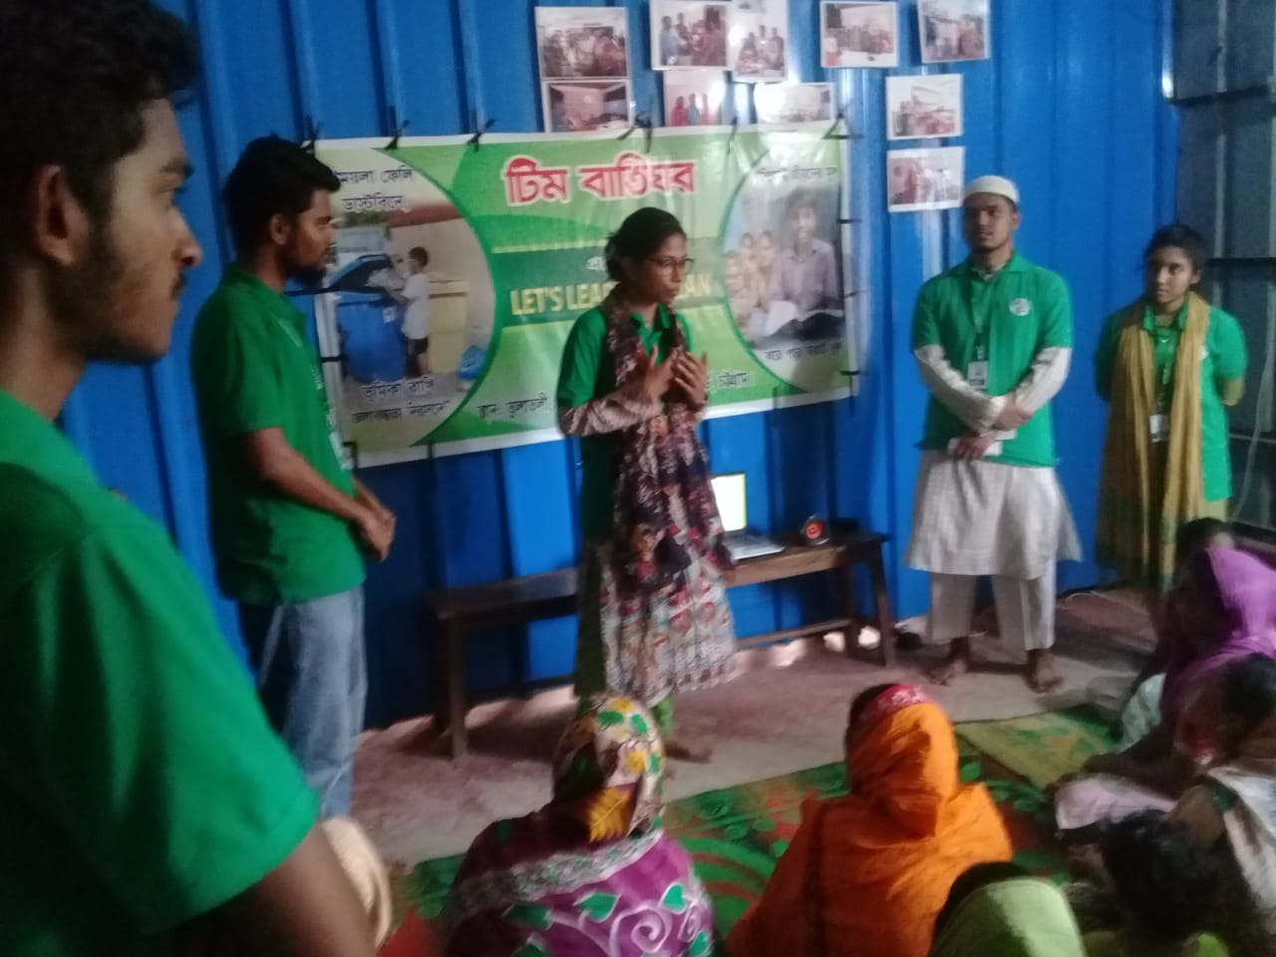
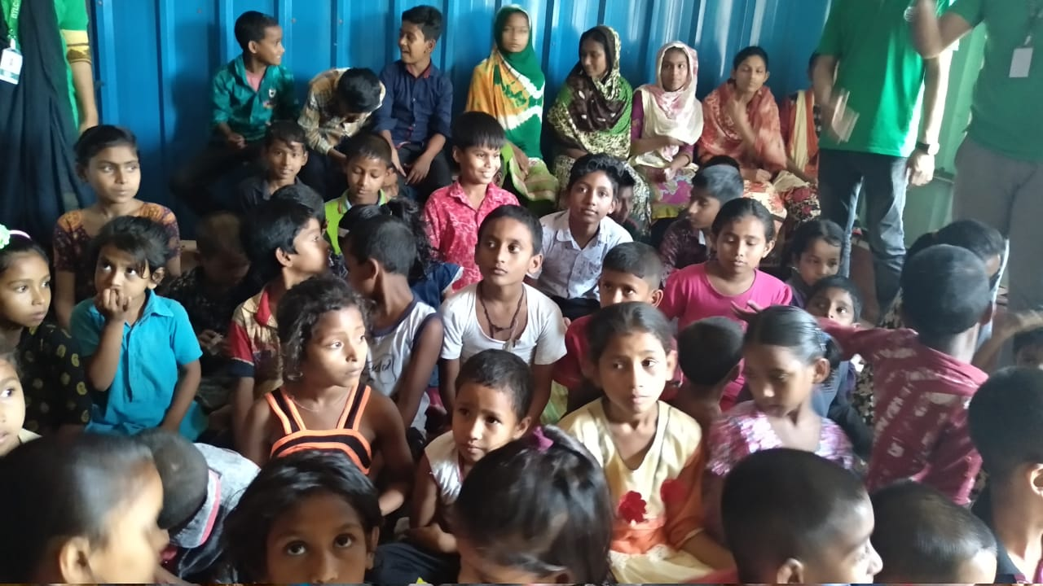
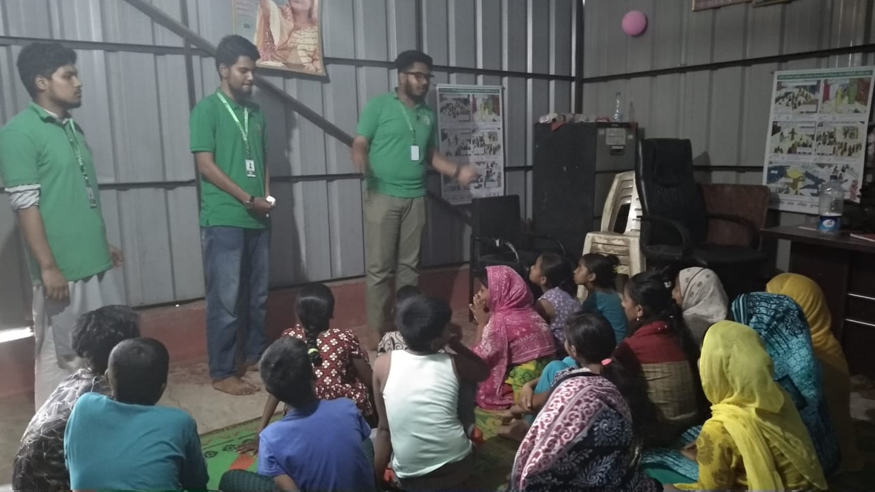
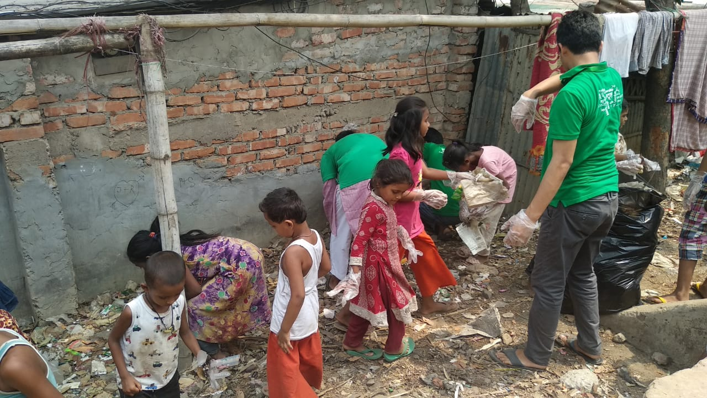
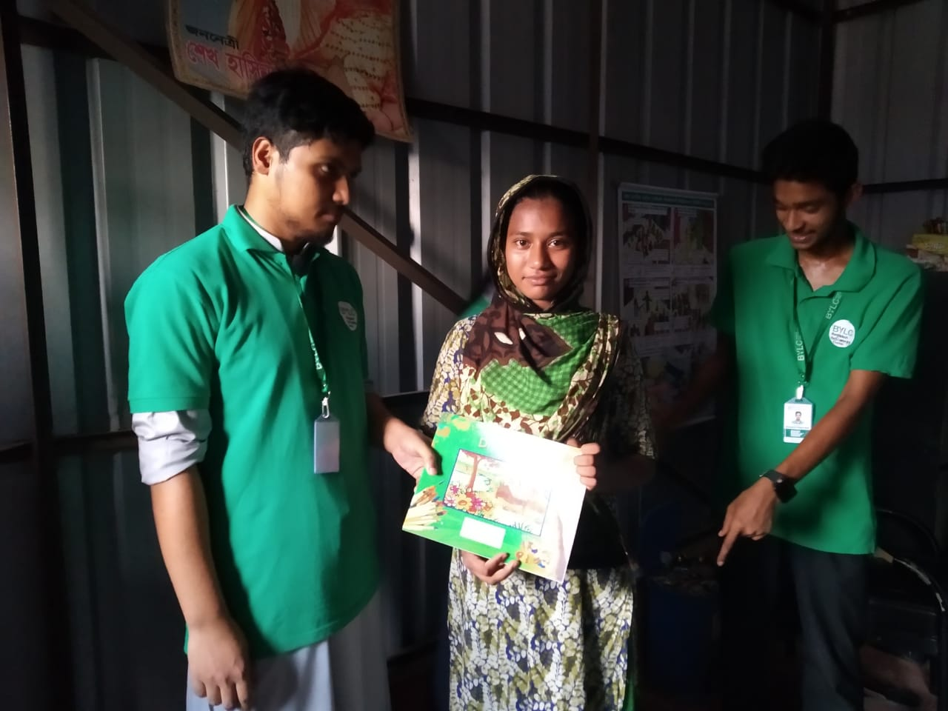

Slide 14

Thank you!

